Slide 1
Lecture 12: Local Methods & Kernels

Slide 2
Nearest neighbor methods
Imagine that you have points on an axis, and you want to categorize a new point (a piece of test data)
  One strategy could just be: what data point are you closest to? Well, then, you have the same category as that point

Slide 3
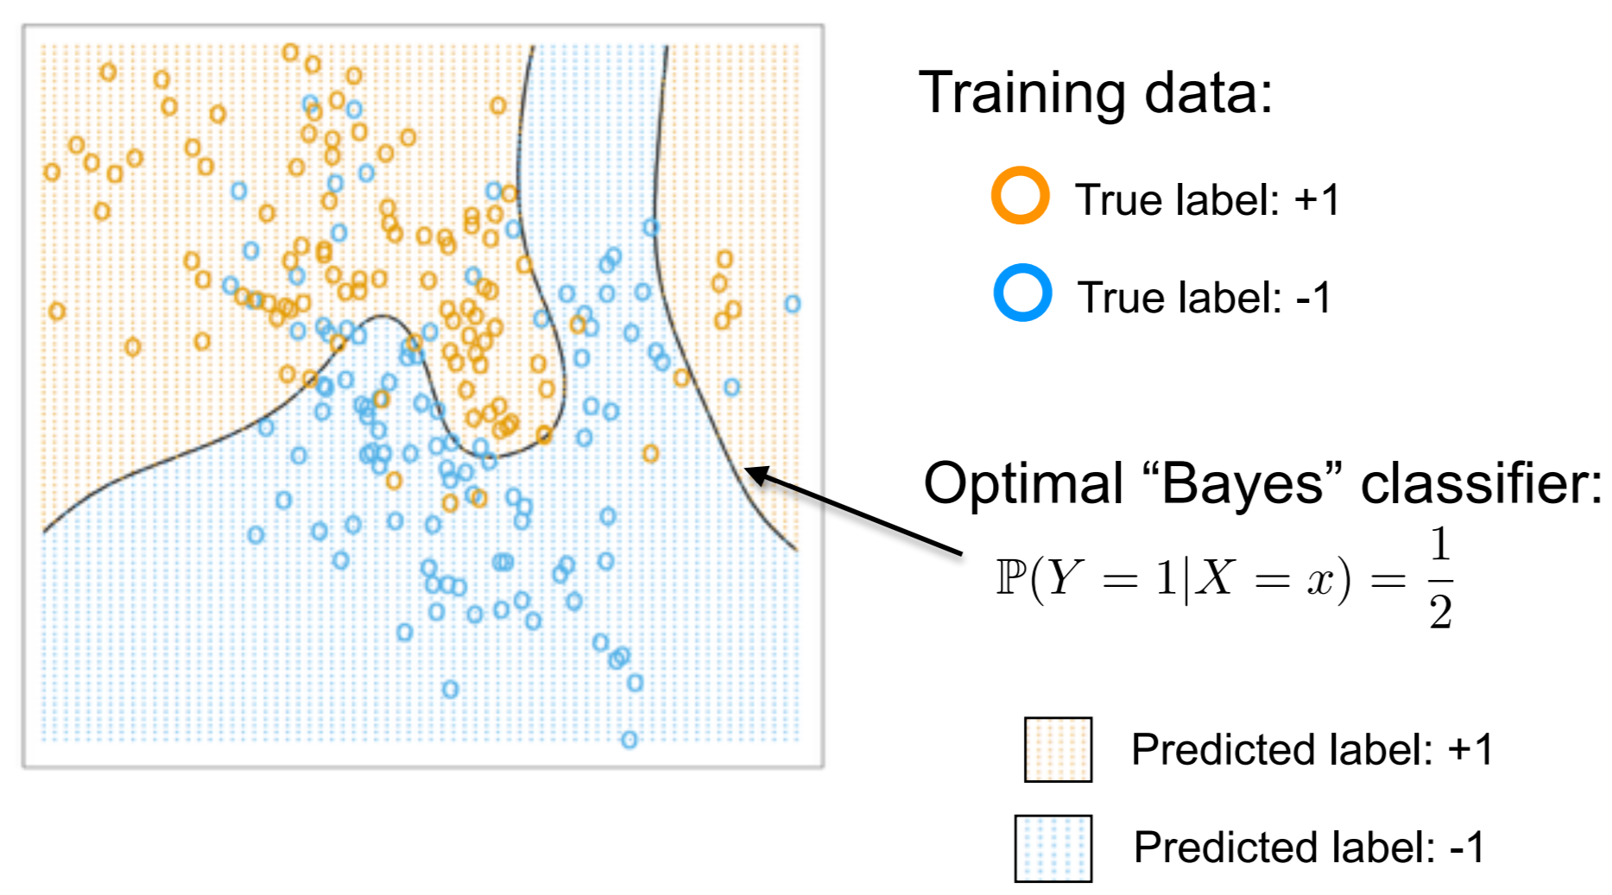
Classification data: Bayes classifier

Slide 4
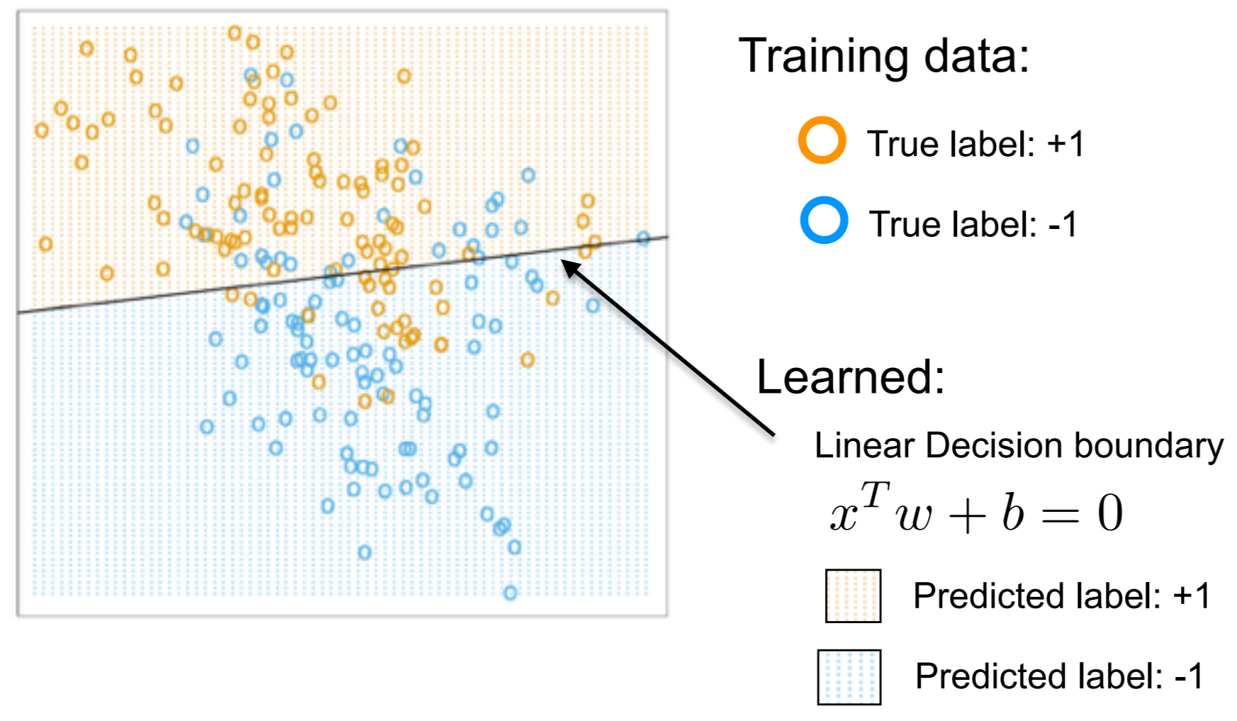
Classification data: linear decision boundary

Slide 5
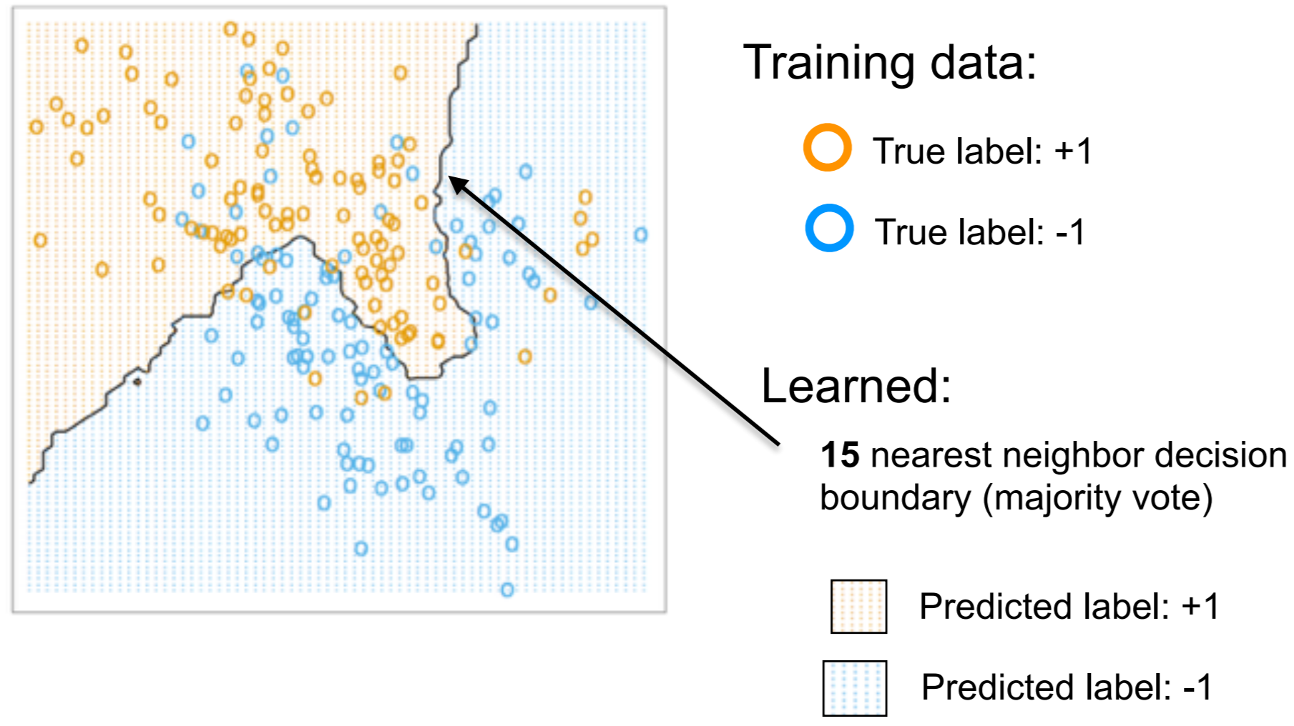
15 nearest neighbor boundary

Slide 6
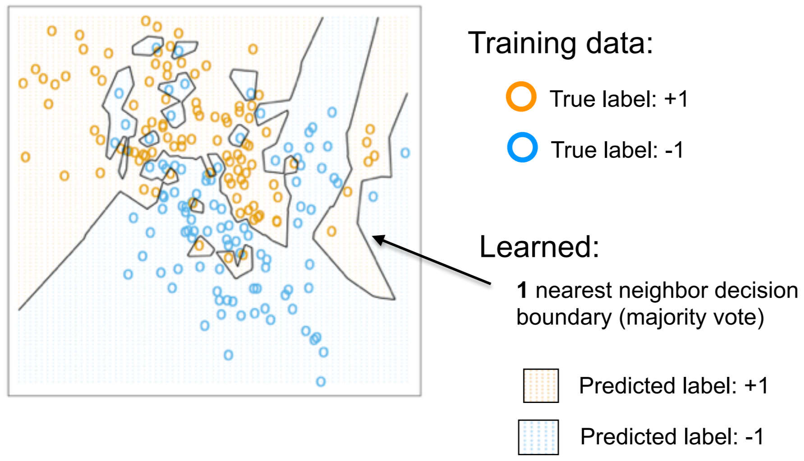
1 nearest neighbor boundary

Slide 7
Nearest neighbor
Nearest neighbor has tradeoffs (pros and cons)
And a decision point: we looked at 15 vs 1 nearest neighbor—what’s the difference and what’s the “best” number to use (if such a thing exists)

Slide 8
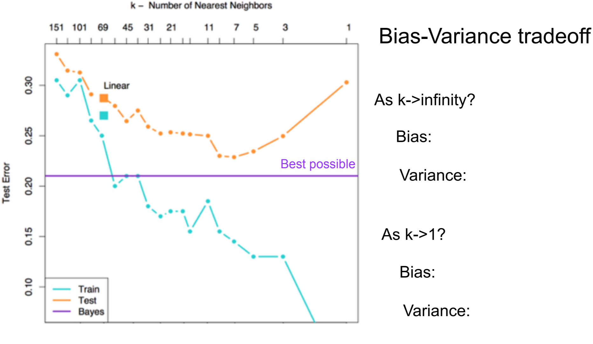
k-nearest neighbor & error

Slide 9
k-nearest neighbor & error
As n->∞
  Your data becomes dense
  Your error decreases
  Your error remains roughly twice the Bayes error
Regardless of your n, method performance largely depends on how well your training data represents the overall data
  Which is generally true of machine learning, but especially true here
  Draw an example of when this is especially true

Slide 10
Nearest neighbor summary
Very simple to explain and implement
No training! Can be computationally demanding depending on dataset size and k
Can use any form of distance (not just Euclidean, as we did)
Smoothing with kernels can improve performance
With a lot of data, “local methods” have strong, simple theoretical guarantees. With not a lot of data, neighbors aren’t local and methods suffer for it

Slide 11
Kernel methods
We’ve seen them before (SVM) and we’ll see them again (PCA)
Motivation: as the number of features increases, computational difficulty of learning can skyrocket
Problem in machine learning: Represent (often high-dimensional) data
Problem, re-framed: Calculate a similarity measure in the feature space, then apply machine learning algorithm to this similarity measure

Slide 12
What exactly is a kernel?
A function that takes as input vectors in the original space and returns vectors in the feature space. This function is called a kernel function.
Can be thought of as modeling the difference between each individual pair of data and then modeling those differences rather than trying to learn how every feature interacts across all of the data

Slide 13
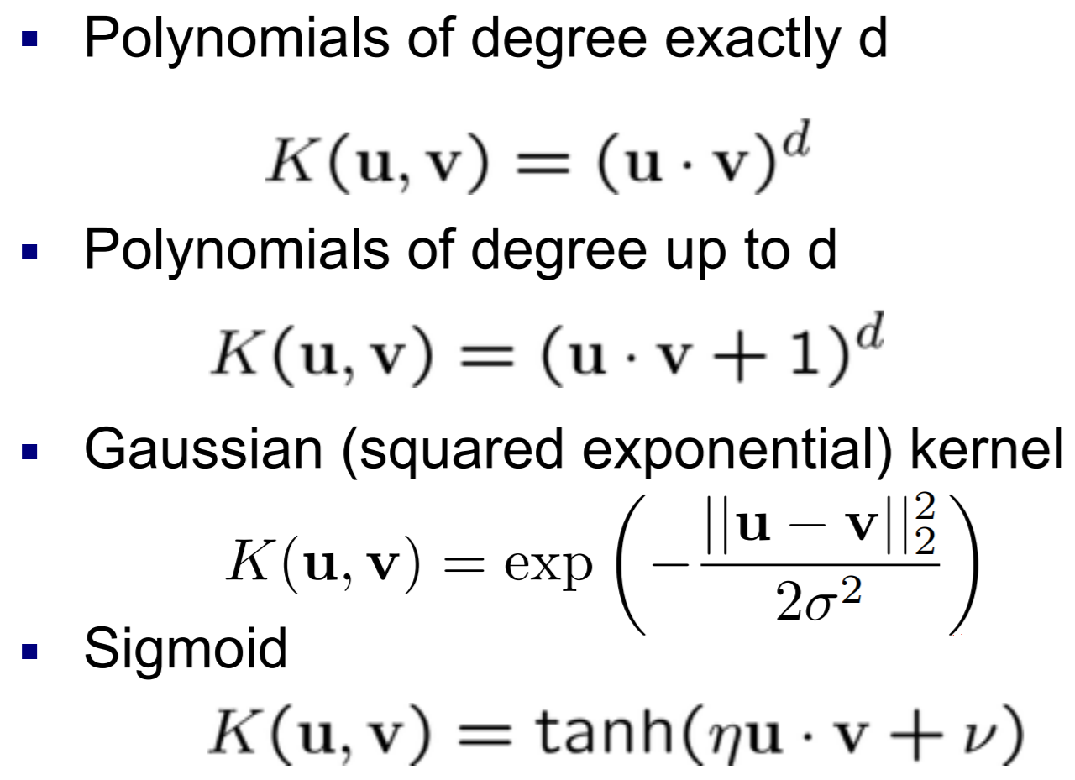
Common kernels (you don’t need to know these)

